Slide 1

FORTRAN by TRAN
Final Project Presentation
CSC372
Prof. Christian Collberg
Akshith Thumma
Graham Walker
28th April 2020

Slide 2
Introduction- FORTRAN by TRAN
One of the First High Level Languages
The advancement in Scientific Computation
The corner stone of modern programming
The vast amount of Literature about Scientific Computing FORTRAN

Slide 3
The Evolution
Fortran was developed by a team of programmers at IBM led by John Backus
First published in 1957
Big versions were 66’ 77’ 90’ and 95’
Usage in hardware
FORTRAN old age vs FORTRAN new age

Slide 4
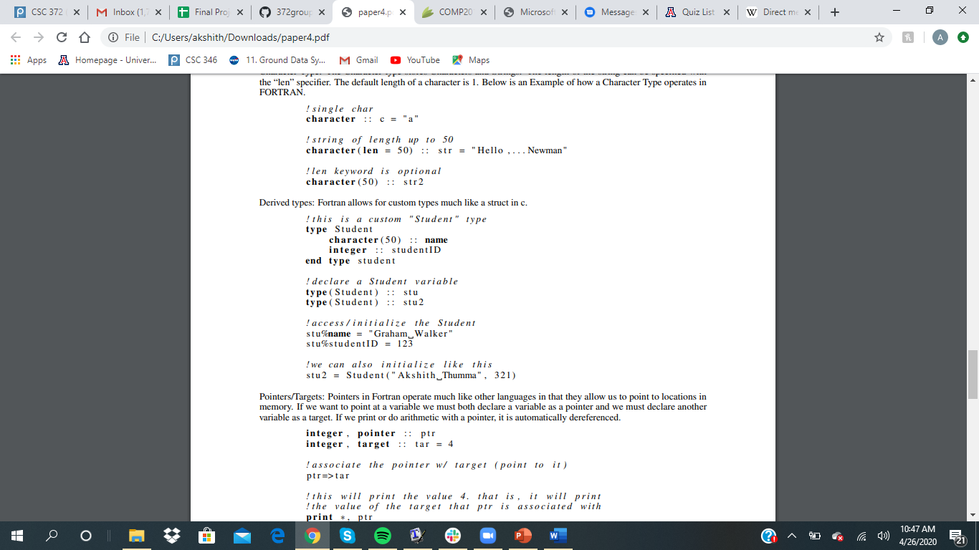
Data Types
Integer Type
Real Type
Complex Type
Character Type
Derived Types
Pointers

Slide 5
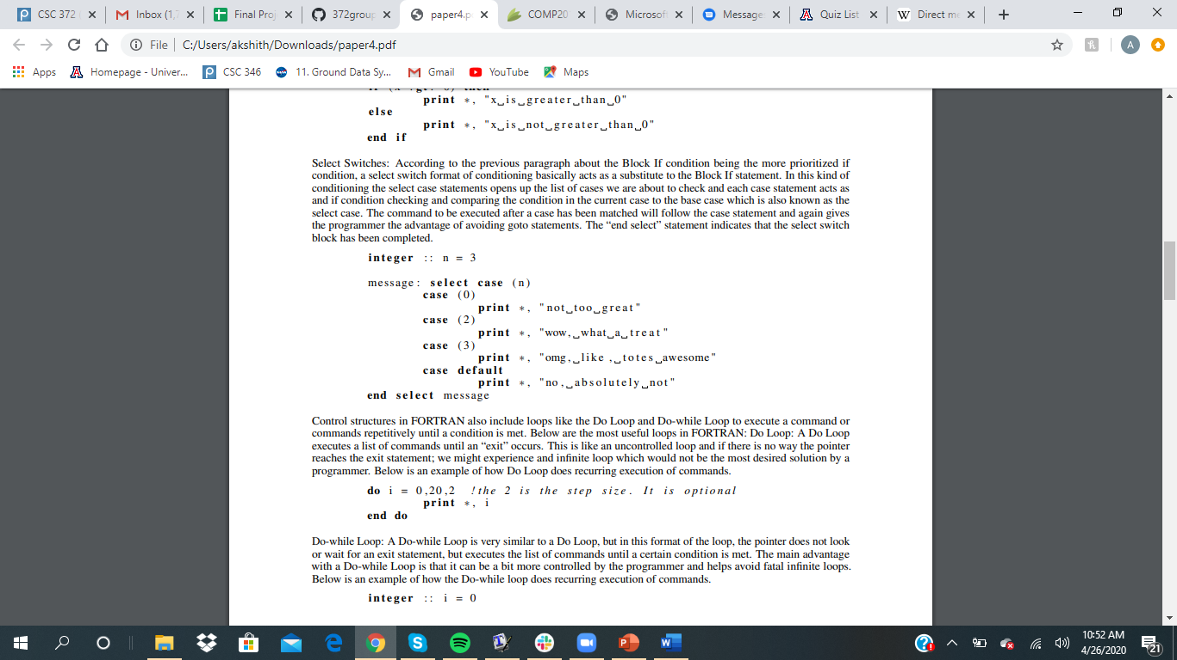
Control Structures
Logical If
Block If
Select Switches
Do-while Loops

Slide 6
Parallel FORTRAN
Compilation time Difference.
Threads in parallelization.
The compiler and processor work together to find operations that can be performed simultaneously.
FORTRAN 95’, one of the best for parallelization.

Slide 7
Conclusion
Practicality of the Language.
Industrial use of the language extends from space research to arithmetic computations.
Financial Software and MATLAB
Hardware use has subsequently decreased.

